Slide 1
Error categorization protocol
Aims

Slide 2
Error categorization protocol
Brief overview of analysis framework

Slide 3
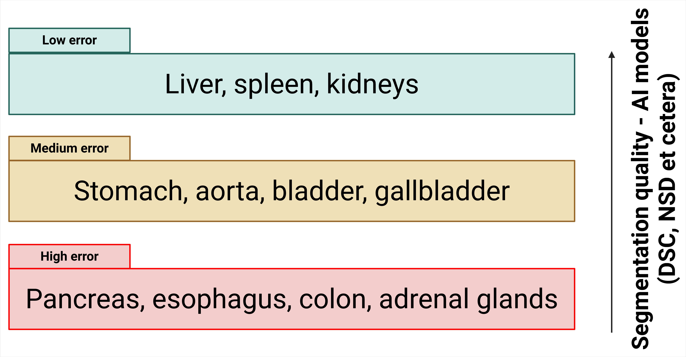
Error categorization protocol – 4 aims
Aims
Introduction:
Several benchmarking studies exist, which categorize organs based on difficulty of segmentation by AI-based models.

Slide 4
Steps
Ground truth
Step 1: Ground truth & predicted segmentations
Dataset: CT-ORG (available via TCIA) [dataset link; DOI]
140 CT scans
Each scan contains 3D segmentation masks
Liver, lungs, bones, kidneys and bladder
Predict: Liver segmentations only, using the trained TotalSegmentator model.

Slide 5
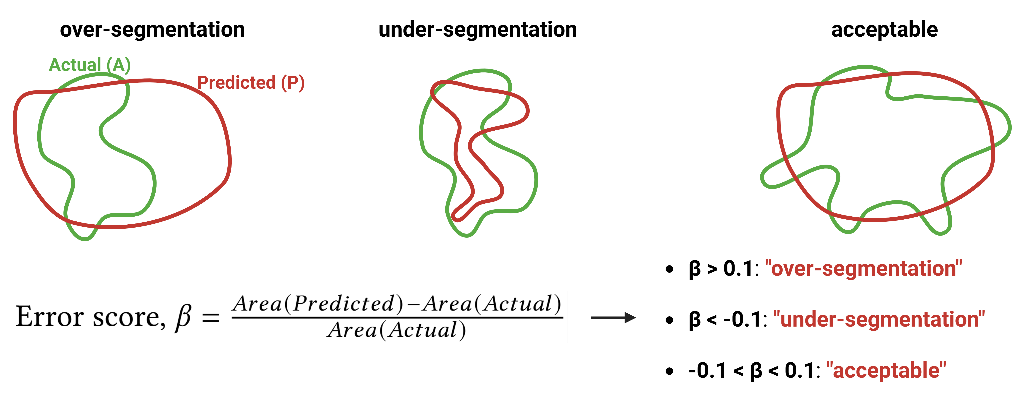
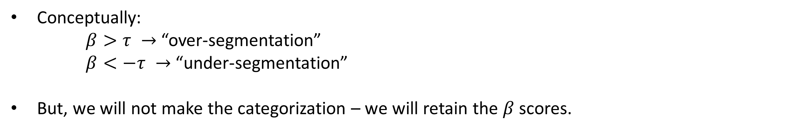
Steps
Error type quantification
Step 2: Categorize Quantify error types → under / over-segmentation
Conceptually:
$β>τ →$ “over-segmentation”
$β<−τ →$ “under-segmentation”
But, we will not make the categorization – we will retain the $β$ scores.

Slide 6
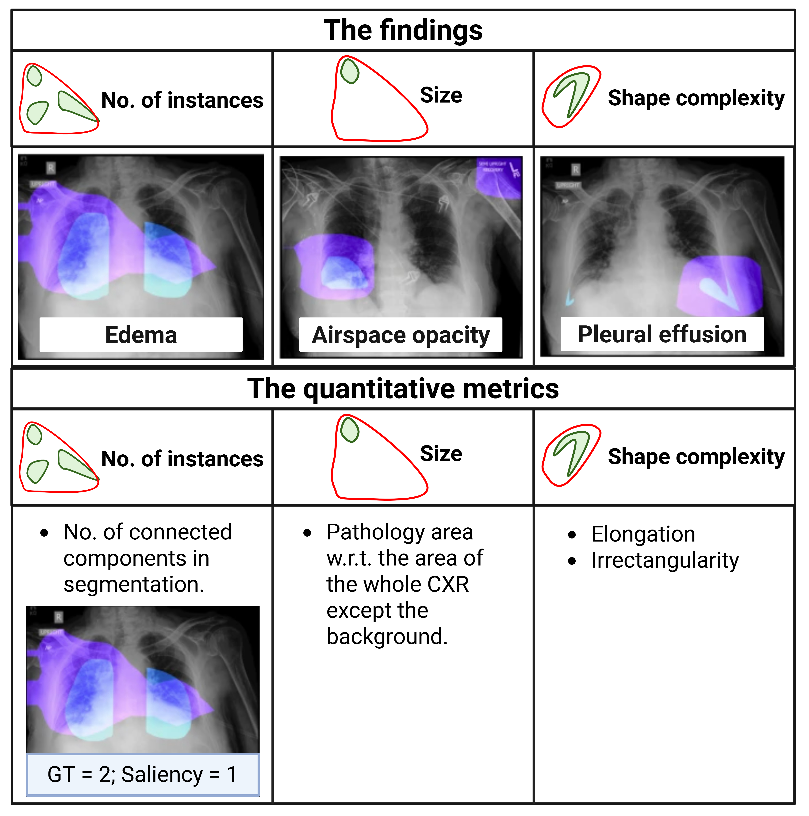
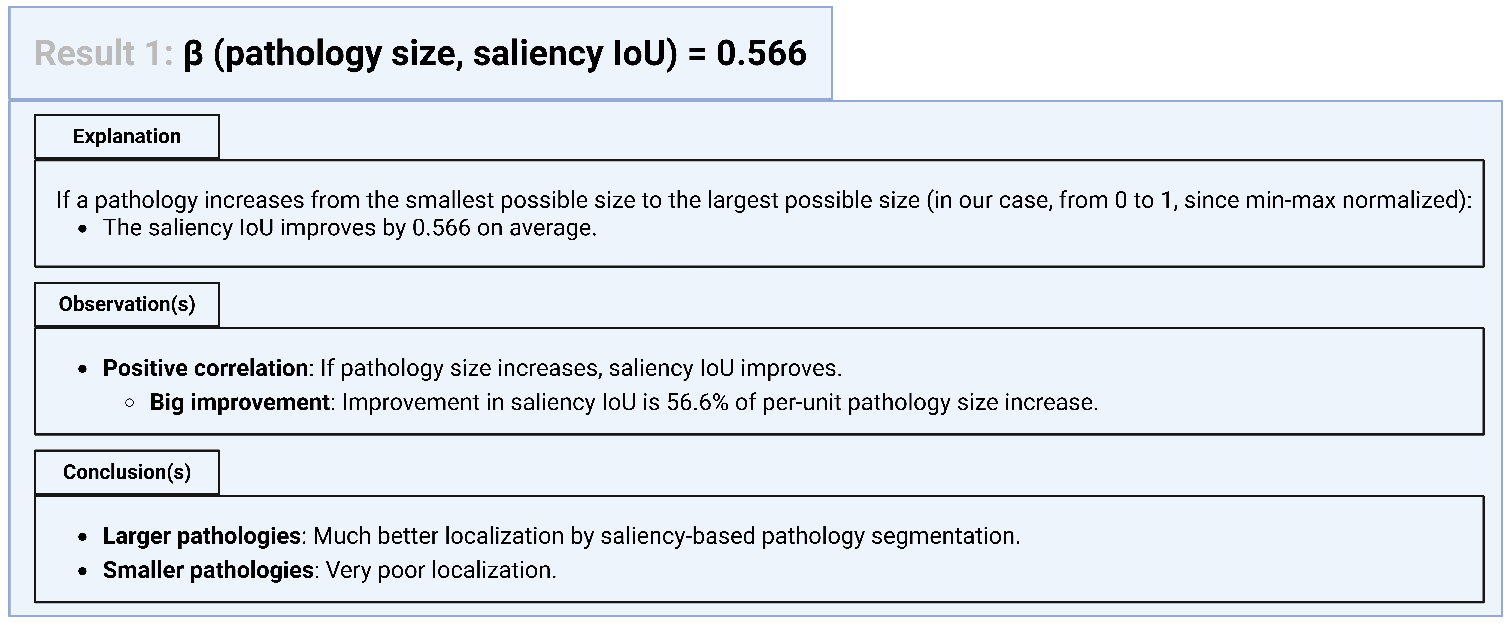
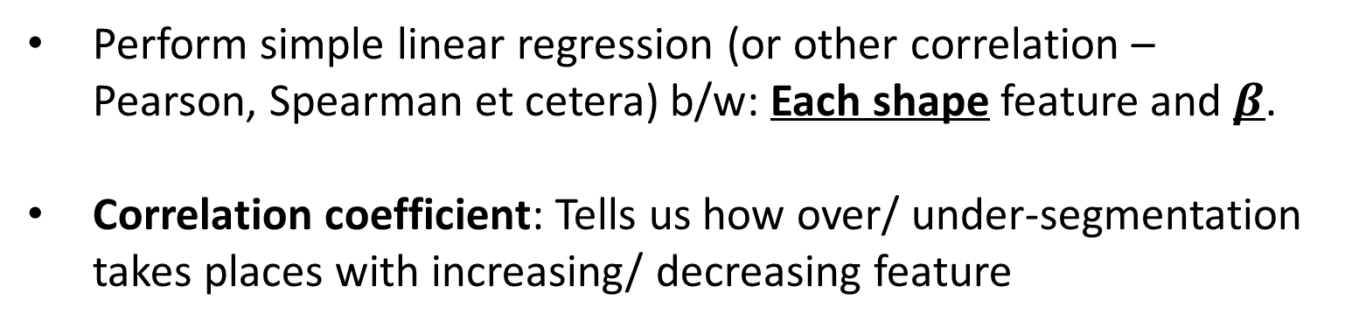
Steps
Correlate features to scores
Step 3: Correlate features to scores
Perform simple linear regression (or other correlation – Pearson, Spearman et cetera) b/w: Each shape feature and $β$.
Correlation coefficient: Tells us how over/ under-segmentation takes places with increasing/ decreasing feature

Slide 7
Steps
Error localization (work in progress)
Step 4: Next, I want to ask two questions:
4A: What are the shape statistics of just the error regions?
4B: In what regions of the organ are we most likely to see errors?
Can we have a heatmap on the organ that tells us likelihood of AI-based segmentation model making an error in that region?

Slide 8
Thank you!

